Slide 1
Lecture 8 Red/black trees
EECS-214

Slide 2
Note
If you’re like me, then red/black trees will make you feel stupid
You’ll think
“I’d never have thought of that”, or
“I understand every individual step and yet I still don’t feel like I understand the whole thing”

Slide 3
You’re not stupid
People spent years figuring this stuff out
AVL trees (first self-balancing trees)
Self-balancing trees with variable fan-out
2-3 trees (1 or 2 keys per node)
Some balancing happens by grouping nodes into bigger nodes
2-3-4 trees (up to 3 keys per node)
Red/black trees are a kind of encoding of 2-3-4 trees in binary tree
… which are themselves a form of B-tree (the standard data structure used for databases like Oracle)
Each design makes sense in terms of the previous design
Each design is better in some way
But also more obscure
So it’s hard to get the intuitions just by jumping into red/black trees
But unfortunately, it’s not worth 2 weeks of our time to study all the precursors

Slide 4
Binary search trees
8
Binary tree
Each node labeled with a value
Number, string, or some other set that has a total order on it
Has the magic binary search tree property
For any node
All the nodes in the left subtree have labels ≤ to its label
All the nodes in the right subtree have labels ≥ to its label
Corollary: in-order traversal of tree visits nodes in sorted order
2
9
1
6
4
7
3
5

Slide 5
Inorder traversal
Inorder(node) {
Inorder(node.leftChild)
print node
Inorder(node.rightChild)
}
Output:
1 3 2 6 5 7 4
1
2
3
4
5
6
7

Slide 6
Searching a BST
Start at root
Move down
Move left or right depending on value of key
When you find the key return the node
Or return null if you run off the end of the tree
Search(node, int k) {
while (node != null && node.key != k) if (k < node.key) node = node.left; else node = node.right;
return node; }

Slide 7
A bad tree to search
1
2
3
4
5
6
7
In the worst case, a tree is effectively a linked list

Slide 8
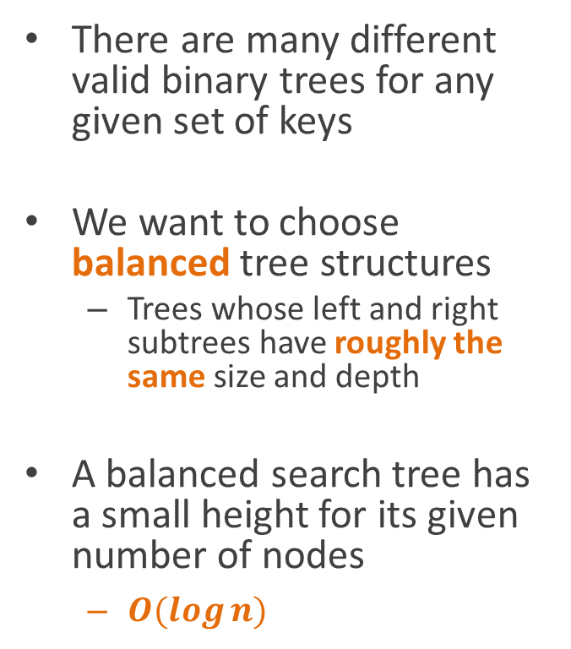
A good tree to search
There are many different valid binary trees for any given set of keys
We want to choose balanced tree structures
Trees whose left and right subtrees have roughly the same size and depth
A balanced search tree has a small height for its given number of nodes
$O(\log{n)}$
4
2
6
1
3
5
7

Slide 9
Self-balancing trees
Adapt their shapes as we add/remove elements
Generally modified version of normal binary search tree
Same algorithms for search, insertion, deletion
But post-processing added to insertion and deletion operations to rebalance tree
4
2
6
1
3
5
7

Slide 10
A bad algorithm
5
3
7
After each modification:
Walk the tree to count all the nodes
Make a new, perfectly balanced tree with just that number of nodes
That turns out to be easier than you might think, but it’s still expensive
Copy the keys from the old tree to the new tree
Throw away the old tree
2
4
6
4
2
6
1
3
5
7

Slide 11
Tree rotation
4
A tree rotation is an operation that
Changes the parent/child relationships of a group of nodes
Without changing the in-order traversal of the nodes
In other words, it preserves the binary-search-tree property
It maintains it as an invariant
2
5
1
3
Rotate right
Rotate left
2
1
4
3
5

Slide 12
Right rotation
b
RotateRight(b) {
a = b.left;
b.left = a.right;
a.parent = b.parent
b.parent = a;
a.right = b;
}
b here is usually called the pivot
Demotes pivot, promotes left child
a
5
1
3
Rotate right
Rotate left
a
1
b
3
5

Slide 13
Left rotation
b
RotateLeft(a) {
b = a.right;
a.right = b.left;
b.parent = a.parent
a.parent = b;
b.left = a;
}
Node a is the pivot
Demotes pivot, promotes right child
a
5
1
3
Rotate right
Rotate left
a
1
b
3
5

Slide 14
Key idea of self-balancing
Insertion/deletion is a local operation
Only affects a small part of the tree
If tree starts balanced
We can rebalance it using rotations
In the modified area
And its ancestors
Can safely ignore the rest of the tree
4
2
6
1
3
5
7

Slide 15
Major issues in designing self-balancing trees
How do you tell if a tree is unbalanced?
Don’t want to have to walk the whole tree to see how deep it is
Need to cache information in the nodes to help out
How balanced is balanced enough?
Takes less work to keep a tree “roughly” balanced than perfectly balanced

Slide 16
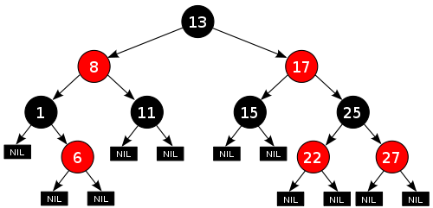
Red-black trees
Color every node of the tree “red” or “black”
Adds only 1 bit of storage per node
Used as a way of determining when the tree is getting unbalanced
Cleverly assign node colors (see coming slides)
Guarantees tree is no more than twice as high as the “optimal” tree

Slide 17
Red-black trees
All interior (non-leaf) nodes have two children
All leaves are marked null (or “nil”) and are black
Can be implemented by treating null pointers as black leaves
It’s common not to bother drawing the null leaves in figures

Slide 18
Invariants on red-black trees
All red-black trees are required to satisfy a set of red-black tree properties
These properties are invariant
All operations (search, insertion, deletion)
Assume they’re satisfied before the operation
Guarantee they’ll be satisfied after the operation
Red-black tree properties
All nodes are labeled either red or black
The root node is always black
All leaves are black
Remember that “leaves” in a red-black tree are null
Both children of any red node are black
Any simple path from a node to one of its descendants has the same number of black nodes as the paths to its other descendants

Slide 19
Why the invariants matter: Bounds on path length
Forcing paths to have the same number of black nodes
Forces them to have approximately the same length
Why?
2
1
4
3
5

Slide 20
Why the invariants matter: Bounds on path length
Proof:
Children of red nodes are required to be black
So a path can never have two consecutive red nodes
Therefore #red ≤ #black nodes
Therefore path length ≤ 2 times #black nodes
But all paths have the same #black nodes
So all paths within a factor of 2 in length
2
1
4
3
5

Slide 21
Why the invariants matter: Bounds on path length
Proof:
So the heights of two subtrees can only differ by at most a factor of 2
So the tree is approximately balanced
2
1
4
3
5

Slide 22
Why the invariants matter: Bounds on path length
Okay, but it’s not perfectly balanced
How much difference does this make?
2
1
4
3
5

Slide 23
Why the invariants matter: Bounds on tree height
We want to show that a red/black tree’s height is within a factor of 2 of the optimal case
We’ll start by proving that the # of black nodes constrains the size and height of the tree
2
1
4
3
5

Slide 24
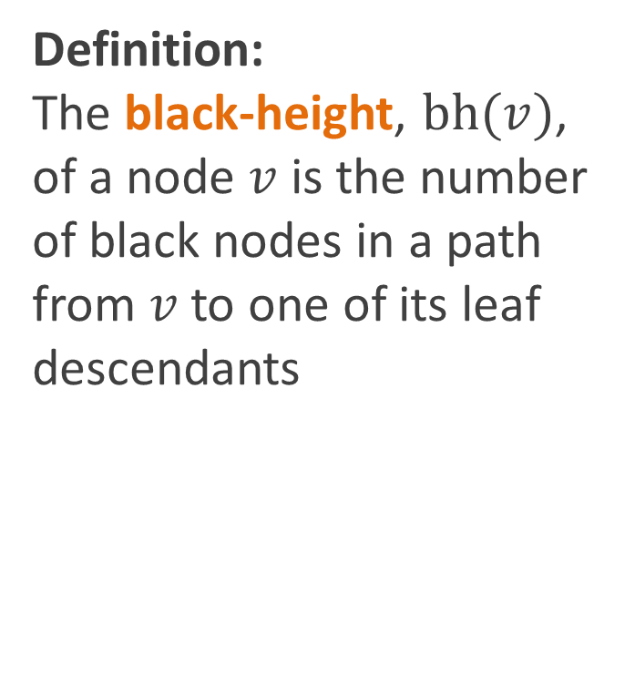
Why the invariants matter: Bounds on tree height
Definition: The black-height, $bh(v)$, of a node $v$ is the number of black nodes in a path from $v$ to one of its leaf descendants
2
1
4
3
5

Slide 25
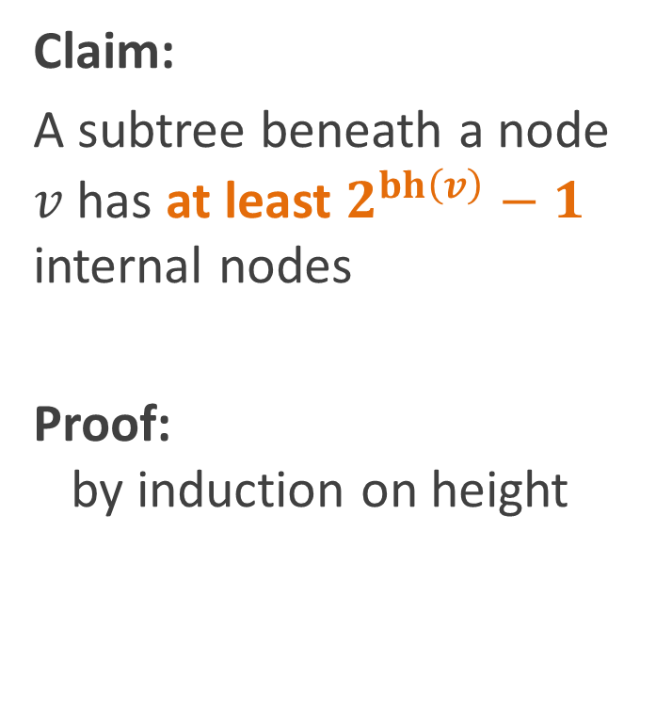
Why the invariants matter: Bounds on tree height
Claim:
A subtree beneath a node $v$ has at least $2^{bh\left(v\right)}−1$ internal nodes
Proof: by induction on height
2
1
4
3
5

Slide 26
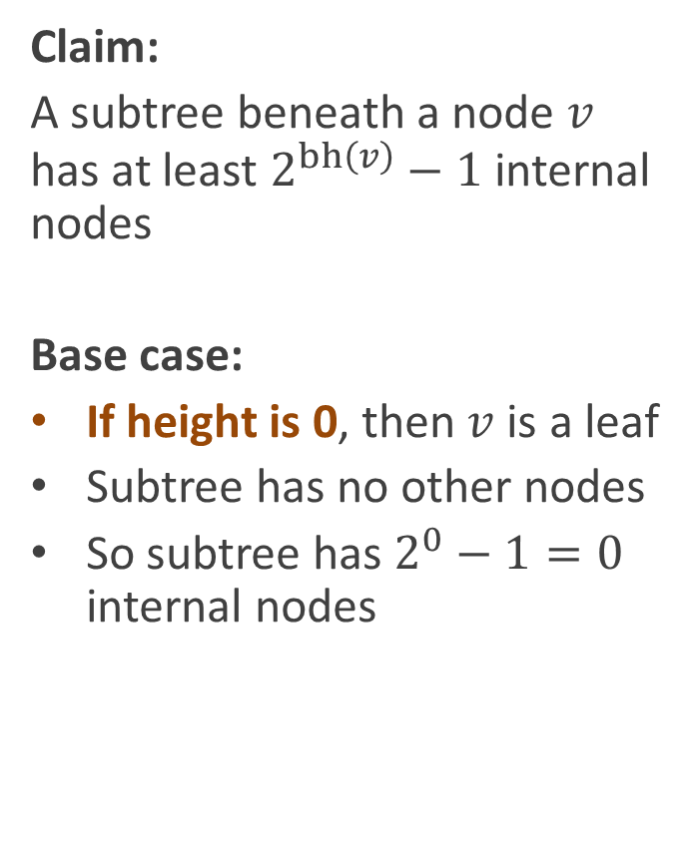
Why the invariants matter: Bounds on tree height
Claim:
A subtree beneath a node $v$ has at least $2^{bh\left(v\right)}−1$ internal nodes
Base case:
If height is 0, then $v$ is a leaf
Subtree has no other nodes
So subtree has $2^{0}−1=0$ internal nodes
2
1
4
3
5

Slide 27
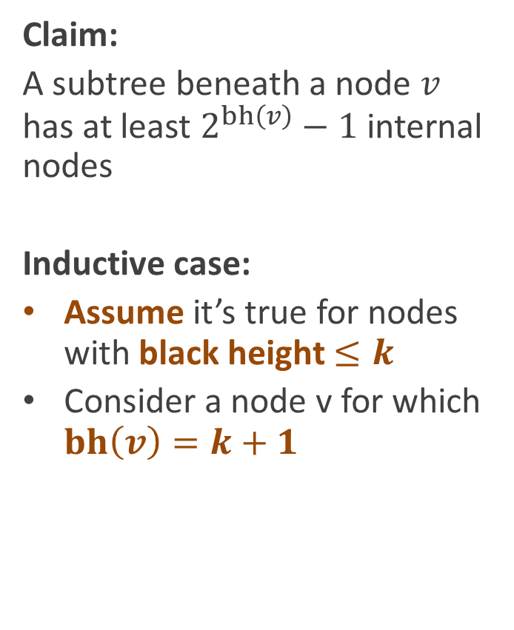
Why the invariants matter: Bounds on tree height
Claim:
A subtree beneath a node $v$ has at least $2^{bh\left(v\right)}−1$ internal nodes
Inductive case:
Assume it’s true for nodes with black height $≤k$
Consider a node v for which $bh\left(v\right)=k+1$
2
1
4
3
5

Slide 28
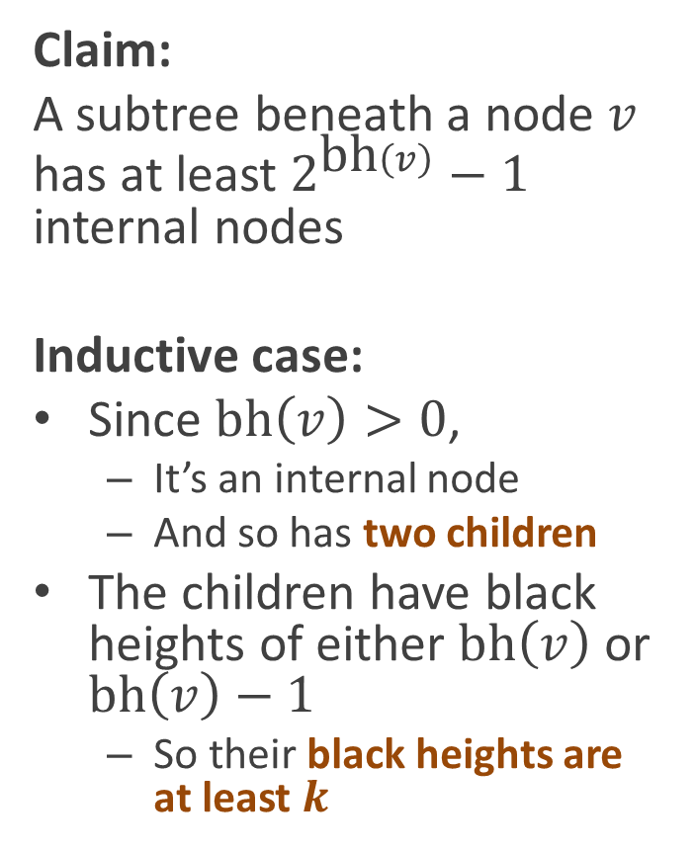
Why the invariants matter: Bounds on tree height
Claim:
A subtree beneath a node $v$ has at least $2^{\text{bh}\left(v\right)}−1$ internal nodes
Inductive case:
Since $\text{bh}\left(v\right)>0$,
It’s an internal node
And so has two children
The children have black heights of either $bh\left(v\right)$ or $bh\left(v\right)−1$
So their black heights are at least $k$
2
1
4
3
5

Slide 29
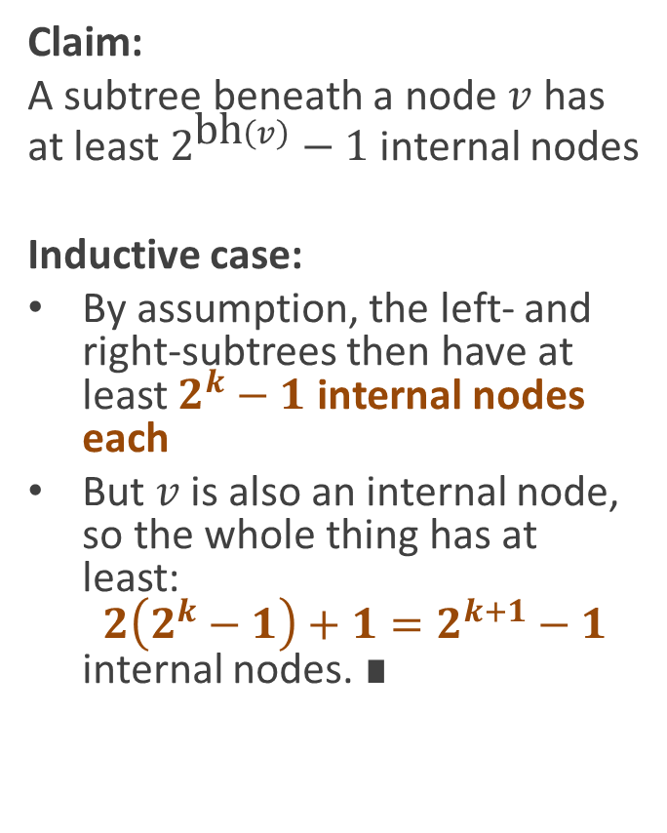
Why the invariants matter: Bounds on tree height
Claim:
A subtree beneath a node $v$ has at least $2^{\text{bh}\left(v\right)}−1$ internal nodes
Inductive case:
By assumption, the left- and right-subtrees then have at least $2^{k}−1$ internal nodes each
But $v$ is also an internal node, so the whole thing has at least: $2\left(2^{k}−1\right)+1=2^{k+1}−1$ internal nodes. ∎
2
1
4
3
5

Slide 30
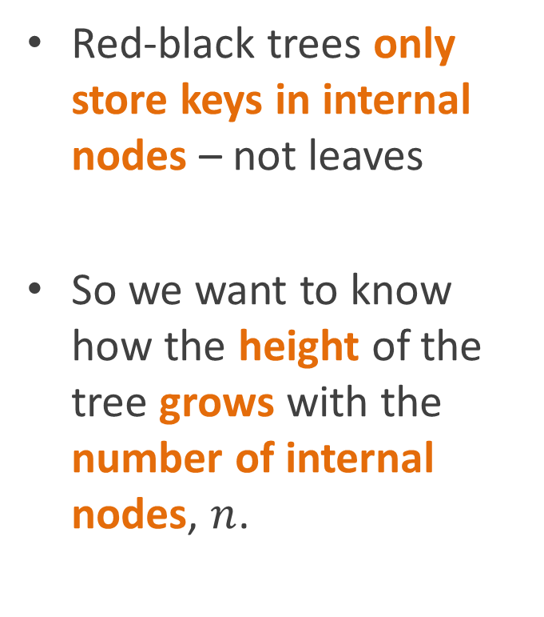
Why the invariants matter: Bounds on tree height
Red-black trees only store keys in internal nodes – not leaves
So we want to know how the height of the tree grows with the number of internal nodes, $n$.
2
1
4
3
5

Slide 31
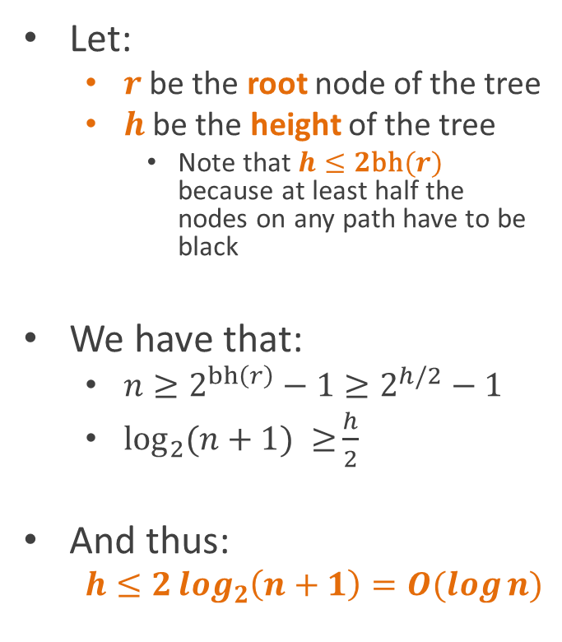
Why the invariants matter: Bounds on tree height
Let:
$r$ be the root node of the tree
$h$ be the height of the tree
Note that $h≤2\text{bh}(r)$ because at least half the nodes on any path have to be black
We have that:
$n≥2^{bh\left(r\right)}−1≥2^{h/2}−1$
$\log_{2}{(n+1) ≥}\frac{h}{2}$
And thus:
$$h≤2\log_{2}\left(n+1\right)=O(\log{n)}$$
2
1
4
3
5

Slide 32
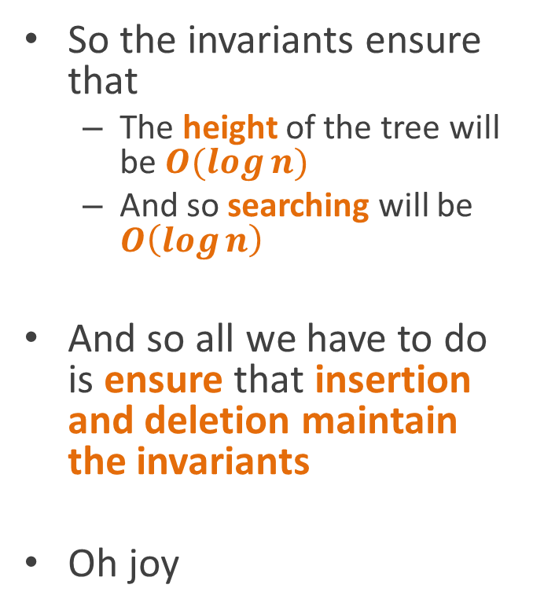
Enforcing the invariants
So the invariants ensure that
The height of the tree will be $O(\log{n)}$
And so searching will be $O\left(\log{n}\right)$
And so all we have to do is ensure that insertion and deletion maintain the invariants
Oh joy
2
1
4
3
5

Slide 33
Enforcing the invariants
Basic idea:
Perform the normal insertion/deletion algorithm for unbalanced trees
Fix up the tree to rebalance it
2
1
4
3
5

Slide 34
Enforcing the invariants: insertion
Insert node as normal
Always color node red
Crawl up the tree fixing violations of invariants
The root node is always black
Both children of any red node are black
Any simple path from a node to one of its descendants has the same number of black nodes
2
1
4
3
5

Slide 35
Outline of the algorithm
Insert new node and color it red
While node != root and both node and parent are red
If uncle (parent’s sibling) is also red
Flip colors of parent, uncle, and grandparent
Node = grandparent (move up two levels)
Else (uncle is black)
If node is a left child of its parent
Node = parent (move up)
Rotate left about node
Flip colors of parent and grandparent
Rotate right about grandparent of node

Slide 36
Outline of the algorithm
Insert new node and color it red
While node != root and both node and parent are red
If uncle (parent’s sibling) is also red
Flip colors of parent, uncle, and grandparent
Node = grandparent (move up two levels)
Else (uncle is black)
If node is a left child of its parent
Node = parent (move up)
Rotate left about node
Flip colors of parent and grandparent
Rotate right about grandparent of node
We assume invariants are satisfied before the insertion
Want to show they’re satisfied afterward

Slide 37
Outline of the algorithm
Insert new node and color it red
While node not root and both node and parent are red
If uncle (parent’s sibling) is also red
Flip colors of parent, uncle, and grandparent
Node = grandparent (i.e. check grandparent in next iteration)
Else (sibling is black)
If node is a right child
Node = parent
Rotate node left
Flip colors of parent and grandparent
Rotate grandparent right
Properties in play
Both children of any red node are black
Could be violated
Any simple path from a node to one of its descendants has the same number of black nodes
Unaffected
Adding a red node doesn’t change any black heights

Slide 38
Outline of the algorithm
Insert new node and color it red
While node not root and both node and parent are red
If uncle (parent’s sibling) is also red
Flip colors of parent, uncle, and grandparent
Node = grandparent (i.e. check grandparent in next iteration)
Else (sibling is black)
If node is a right child
Node = parent
Rotate node left
Flip colors of parent and grandparent
Rotate grandparent right
Properties in play
Both children of any red node are black
Could be violated
Any simple path from a node to one of its descendants has the same number of black nodes
Unaffected
Flips grandparent
But also both of grandparent’s children
So black height consistency is preserved

Slide 39
Outline of the algorithm
Insert new node and color it red
While node not root and both node and parent are red
If uncle (parent’s sibling) is also red
Flip colors of parent, uncle, and grandparent
Node = grandparent (i.e. check grandparent in next iteration)
Else (sibling is black)
If node is a right child
Node = parent
Rotate node left
Flip colors of parent and grandparent
Rotate grandparent right
Properties in play
Both children of any red node are black
Left the same
Any simple path from a node to one of its descendants has the same number of black nodes
Unaffected
Rotating two red nodes leaves black heights unaffected

Slide 40
Tree rotations
4
Rotating two red nodes leave black heights unchanged
2
5
1
3
Rotate right
Rotate left
2
1
4
3
5

Slide 41
Outline of the algorithm
Insert new node and color it red
While node not root and both node and parent are red
If uncle (parent’s sibling) is also red
Flip colors of parent, uncle, and grandparent
Node = grandparent (i.e. check grandparent in next iteration)
Else (sibling is black)
If node is a right child
Node = parent
Rotate node left
Flip colors of parent and grandparent
Rotate grandparent right
Properties in play
Both children of any red node are black
Left the same
But easier to see in the example coming up
Any simple path from a node to one of its descendants has the same number of black nodes
Unaffected
Adding red node, removing red node, and rotating

Slide 42
Insertion example (from CLR)
11
2
14
1
7
15
Starting tree
5
8

Slide 43
Insertion example (from CLR)
11
2
14
1
7
15
Insert new node
Color it red
5
8
4

Slide 44
Insertion example (from CLR)
11
2
14
1
7
15
Invariant violation: red node has red parent
5
8
4

Slide 45
Insertion example (from CLR)
11
2
14
1
7
15
Recolor parent, uncle,
and grandparent
5
8
4

Slide 46
Insertion example (from CLR)
11
2
14
1
7
15
Move to grandparent
5
8
4

Slide 47
Insertion example (from CLR)
11
2
14
1
7
15
Violation
But uncle not red
5
8
4

Slide 48
Insertion example (from CLR)
11
2
14
1
7
15
Move to parent
5
8
4

Slide 49
Insertion example (from CLR)
11
Rotate left
14
7
15
2
8
1
5
4

Slide 50
Insertion example (from CLR)
11
Still a violation
14
7
15
2
8
1
5
4

Slide 51
Insertion example (from CLR)
11
Flip colors on parent
and grandparent
14
7
15
2
8
1
5
4

Slide 52
Insertion example (from CLR)
Rotate grandparent right
7
2
11
1
5
8
14
4
15

Slide 53
Insertion example (from CLR)
No violations!
7
2
11
1
5
8
14
4
15

Slide 54
Complexity analysis
Insert new node and color it red
While node not root and both node and parent are red
If uncle (parent’s sibling) is also red
Flip colors of parent, uncle, and grandparent
Node = grandparent (i.e. check grandparent in next iteration)
Else (sibling is black)
If node is a right child
Node = parent
Rotate node left
Flip colors of parent and grandparent
Rotate grandparent right

Slide 55
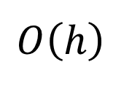
Complexity analysis
$$O\left(h\right)$$
Insert new node and color it red
While node not root and both node and parent are red
If uncle (parent’s sibling) is also red
Flip colors of parent, uncle, and grandparent
Node = grandparent (i.e. check grandparent in next iteration)
Else (sibling is black)
If node is a right child
Node = parent
Rotate node left
Flip colors of parent and grandparent
Rotate grandparent right

Slide 56


Complexity analysis
$$O\left(h\right)$$
Insert new node and color it red
While node not root and both node and parent are red
If uncle (parent’s sibling) is also red
Flip colors of parent, uncle, and grandparent
Node = grandparent (i.e. check grandparent in next iteration)
Else (sibling is black)
If node is a right child
Node = parent
Rotate node left
Flip colors of parent and grandparent
Rotate grandparent right
$$O\left(1\right)$$

Slide 57
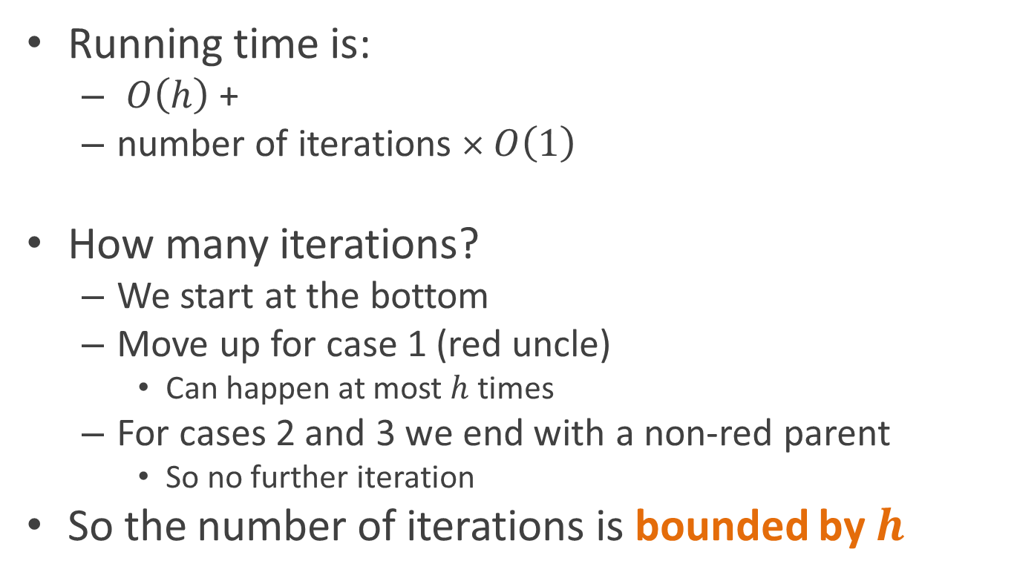
Complexity analysis
Running time is:
$O\left(h\right)$ +
number of iterations × $O\left(1\right)$
How many iterations?
We start at the bottom
Move up for case 1 (red uncle)
Can happen at most $h$ times
For cases 2 and 3 we end with a non-red parent
So no further iteration
So the number of iterations is bounded by $h$

Slide 58

Complexity analysis
Running time is:
$O\left(h\right)+h×O(1)$
$$=O\left(h\right)$$
$$=O(\log{n)}$$

Slide 59
Deletion
Same basic idea
Run the standard deletion algorithm
Fix things up afterward through rotation and recoloring
However more subcases to worry about

Slide 60
Reading
Read CLR chapter 13

